Slide 1
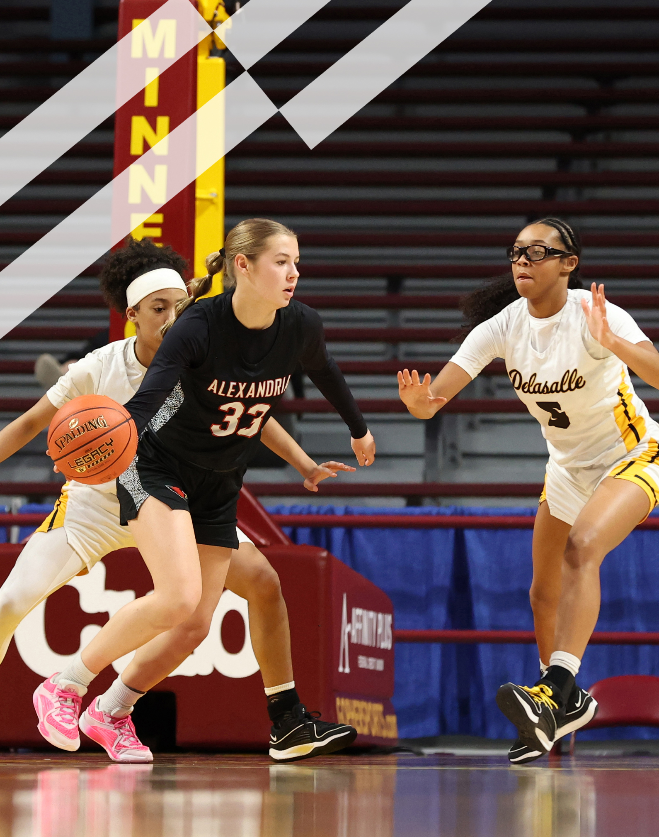
2025-26 NFHS
Basketball
Rules PowerPoint
Rules Changes
Editorial Changes
Mechanical Changes
Points of Emphasis

Slide 2
NFHS Information

Slide 3


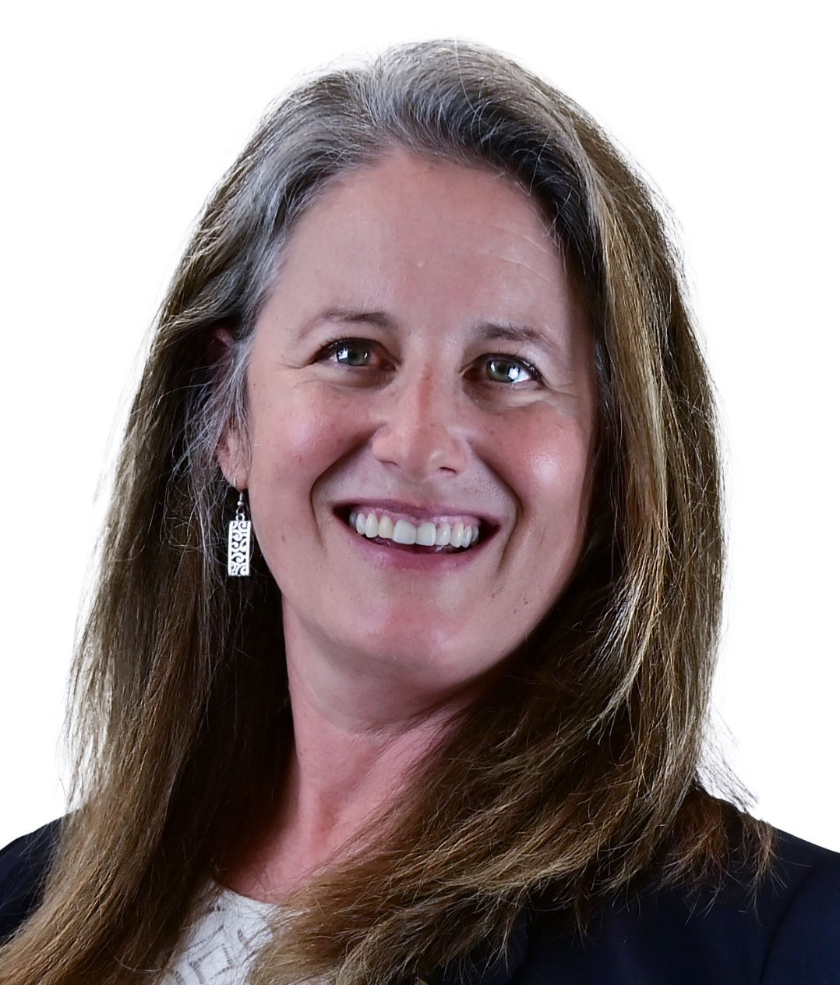

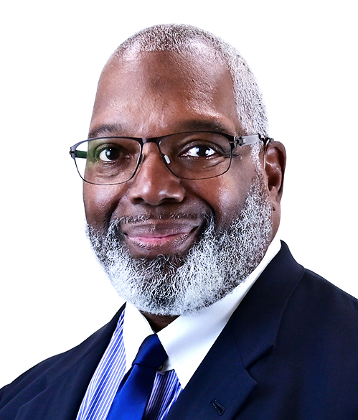
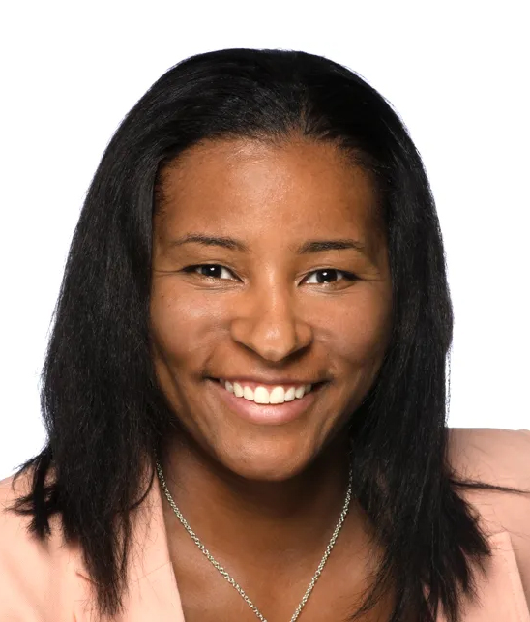

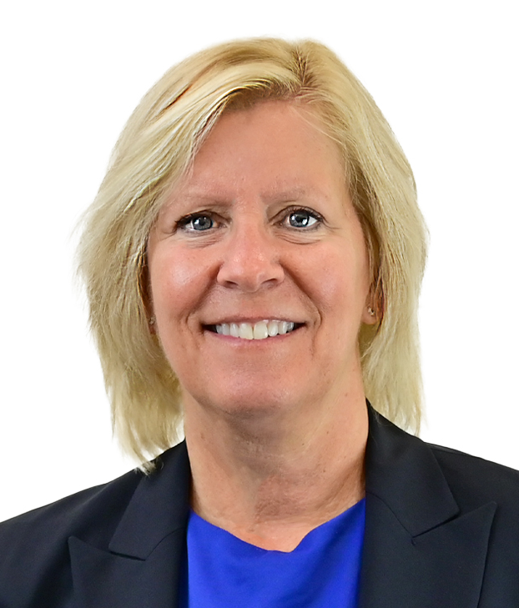

NFHS Rules Review Committee
The NFHS Rules Review Committee is chaired by the chief operating officer and composed of all rules editors. After each committee concludes its deliberations and has adopted its recommended changes for the subsequent year, such revisions will be evaluated
by the Rules Review Committee.
Davis Whitfield
Chief Operating Officer
Lindsey Atkinson
Boys & Girls Lacrosse and Volleyball
Julie Cochran
Cross Country, Soccer and Track & Field
Bob Colgate
Flag Football, Football and Sports
Medicine
Elliot Hopkins
Baseball and Wrestling
Monica Maxwell
Basketball, Field Hockey and Girls Gymnastics
Dan Schuster
Ice Hockey
Sandy Searcy
Softball, Swimming & Diving and Water Polo
James Weaver
Spirit

Slide 4

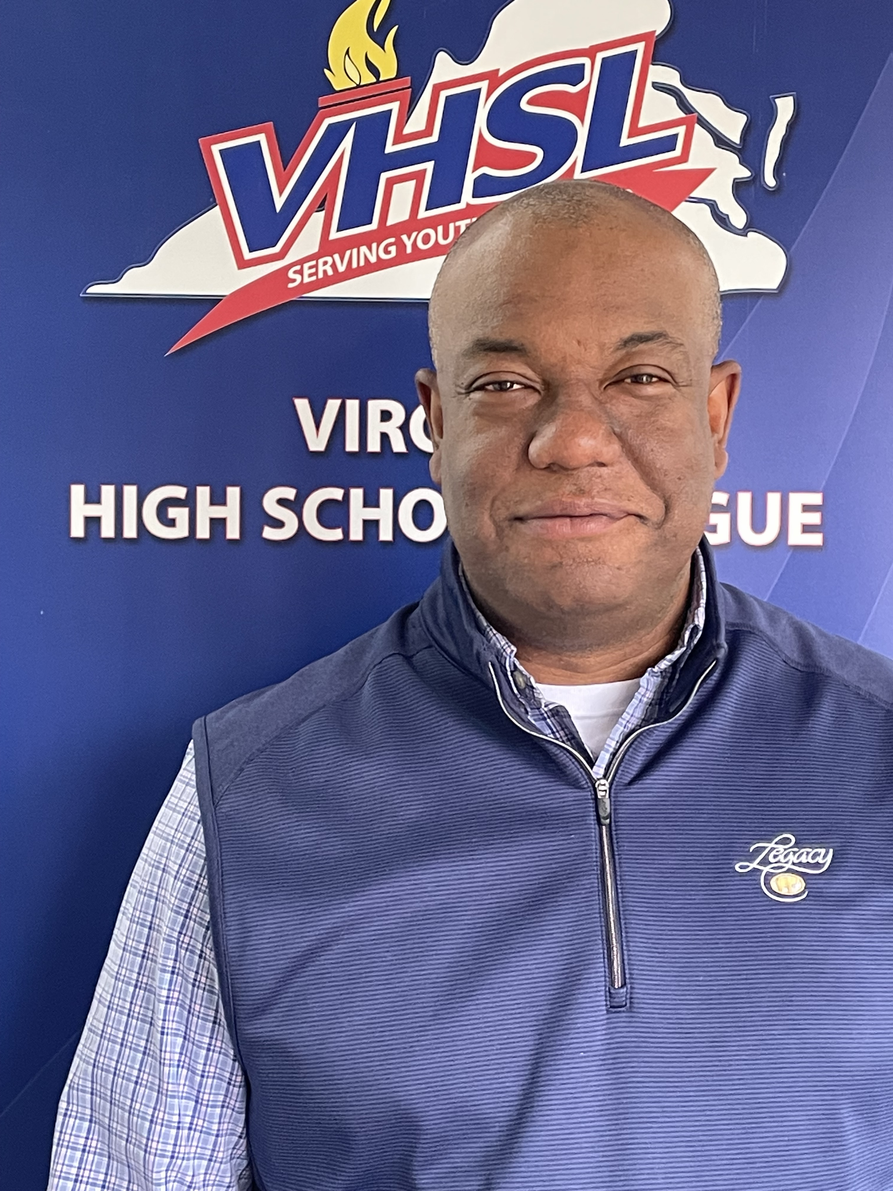
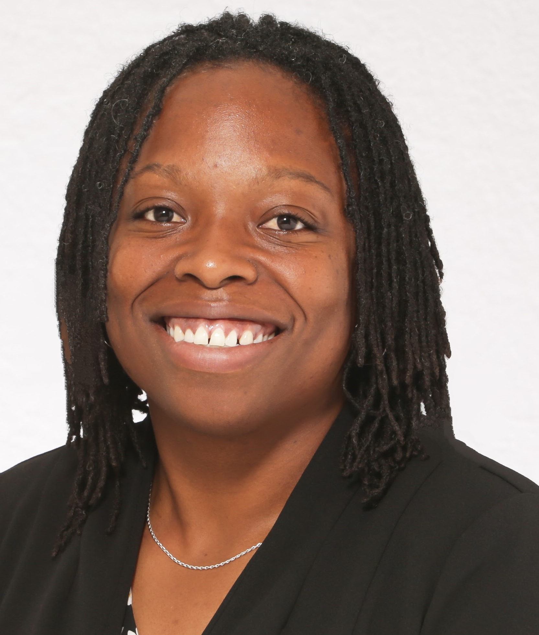
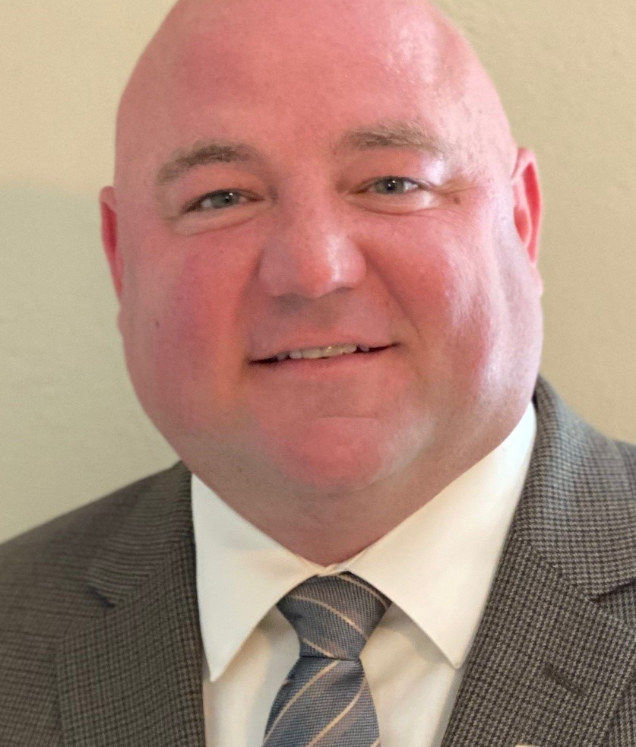





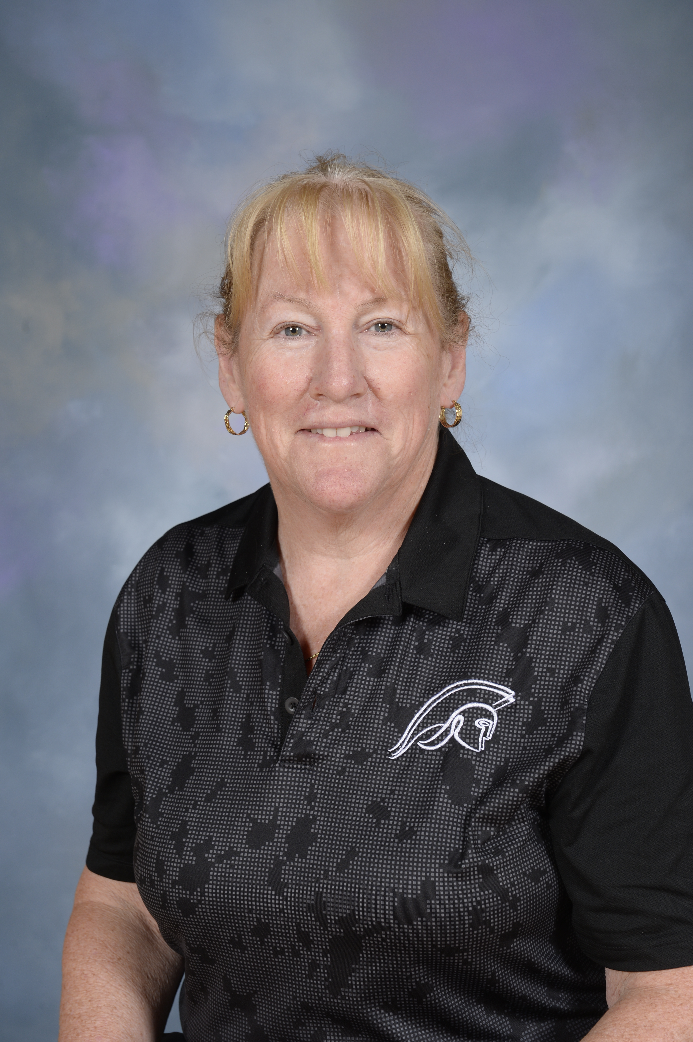
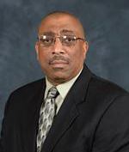
NFHS Rules Committee
Billy Strickland
Anchorage, AK
Chair - 2025
T.J. Halliday
Waterville, ME
Section 1 - 2028
Ty Gafford
Charlottesville, VA
Section 2 - 2025
Sarah Hayes
Columbia, SC
Section 3 - 2028
Brian Lewis
Indianapolis, IN
Section 4 - 2026
Ben Boothe, Ed. D.
Lenexa, KS
Section 5 - 2025
Joseph Garmon
Austin, TX
Section 6 - 2027
Amy Cassell
Oklahoma City, OK
Section 6 - 2027
Lisa Bishop
Las Vegas, NV
Section 7 - 2026
Missy Smith
Wilsonville, OR
Section 8 - 2027
Aleta Moss
Ethete, WY
Section 8 - 2028
Mary Klinger
Somerset, NJ
NFHS Coaches - 2026
Arthur Hardin
Winston-Salem, NC
NFHS Officials - 2025

Slide 5


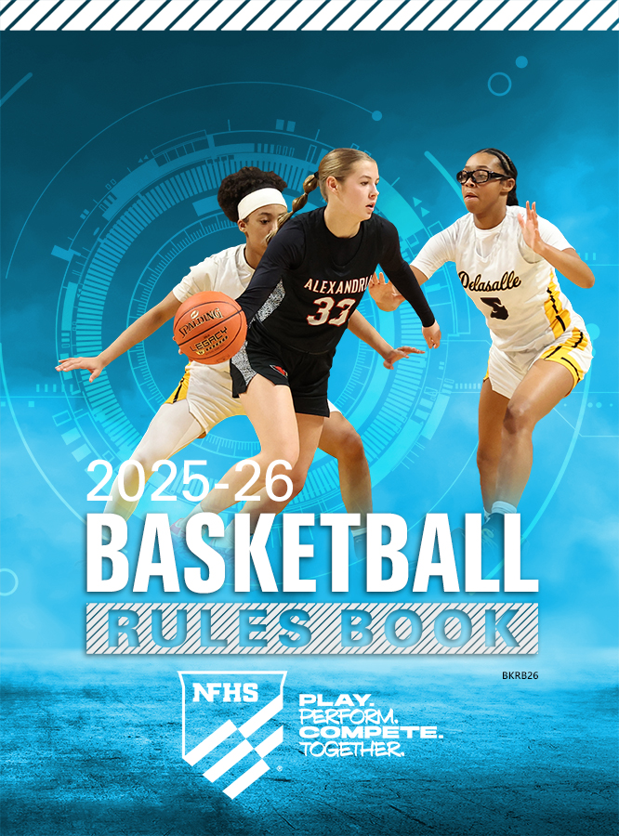
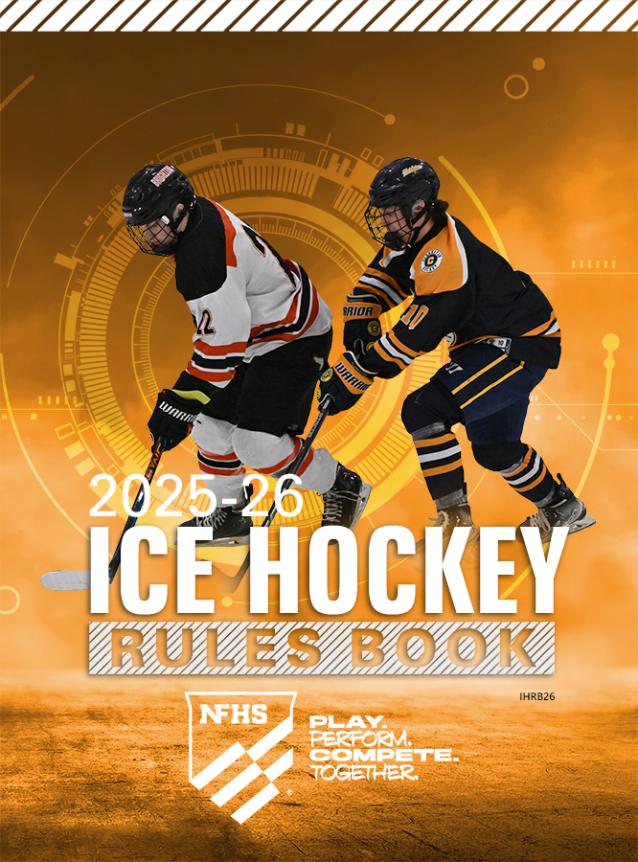




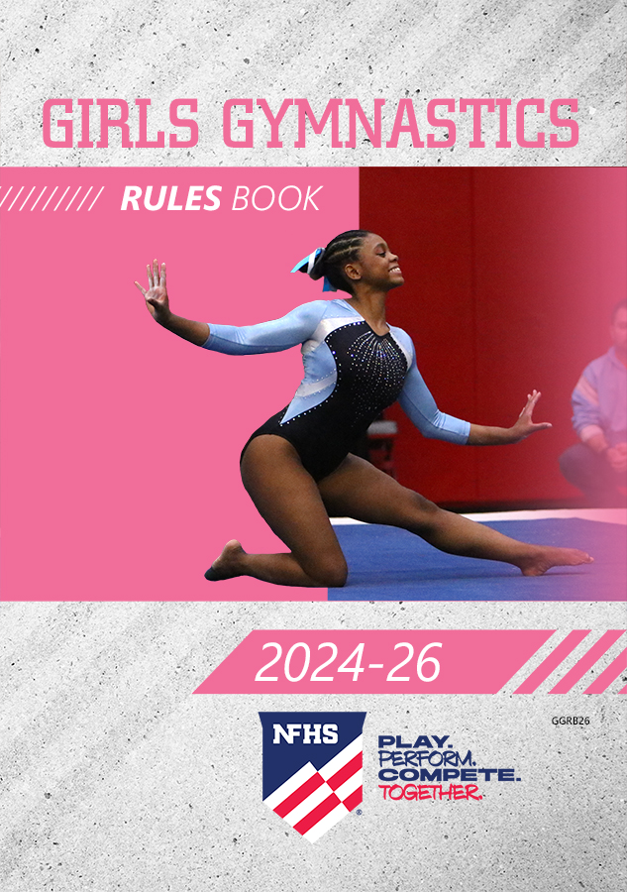


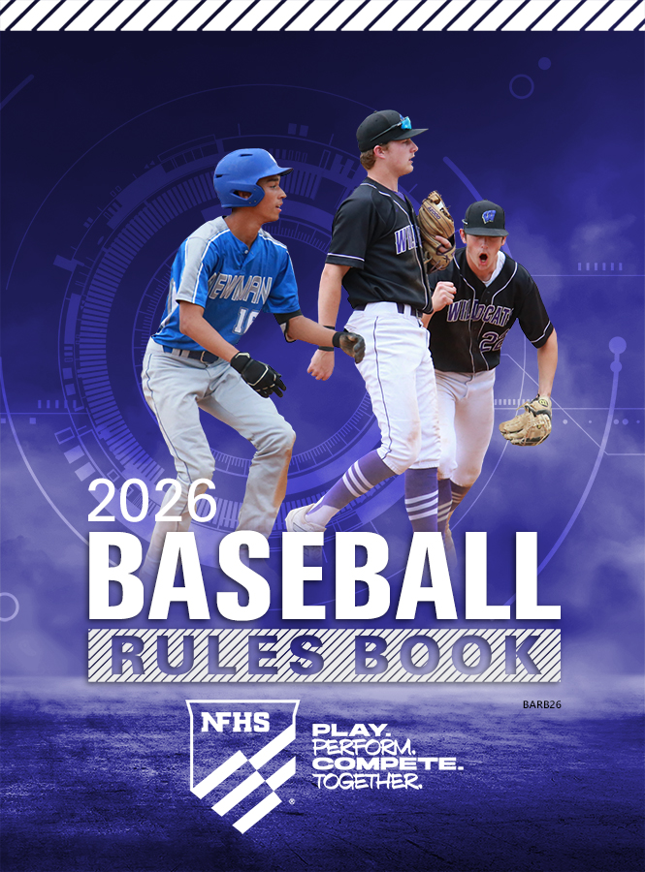
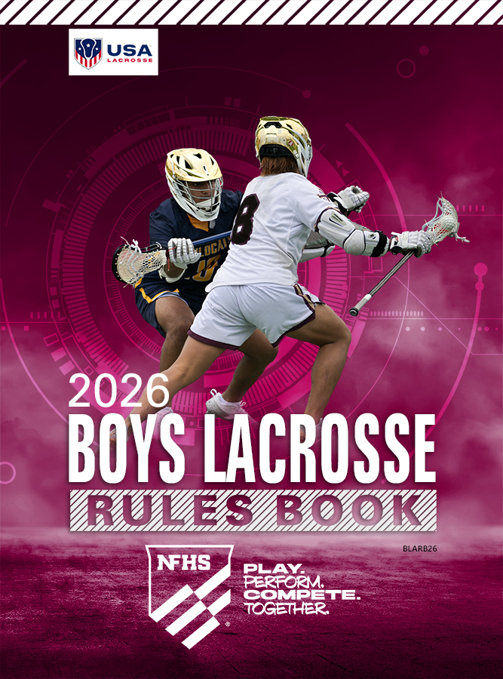



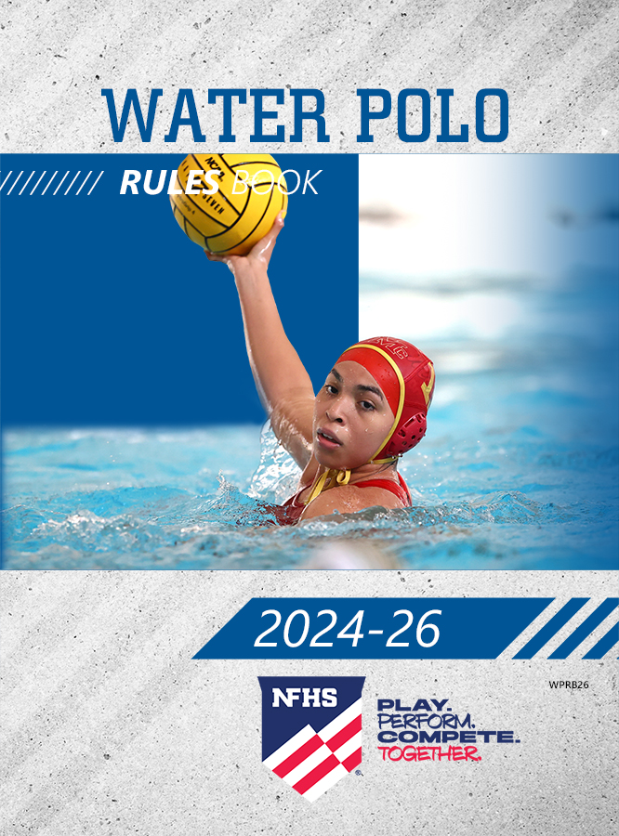
NFHS Publications
The NFHS writes playing rules for 18 sports
for boys and girls at the high school level.
  Publishes 2 million pieces of materials annually.

Slide 6


NFHS Digital
NFHS Digital is the New Publications Platform that includes:
  Rules Books
  Case Books
  Officials Manuals
  Policy Debate Quarterly
  Other NFHS Publications
Visit nfhs.org/NFHSDigital

Slide 7
NFHS Digital – Mobile App
Access via Mobile App:
  View available publications for sale
  View publications assigned to you
  Create comments and save notes
  Highlight important content to review later
  Available on App Store and Google Play

Slide 8
2025-26 NFHS Basketball
Rules Changes

Slide 9
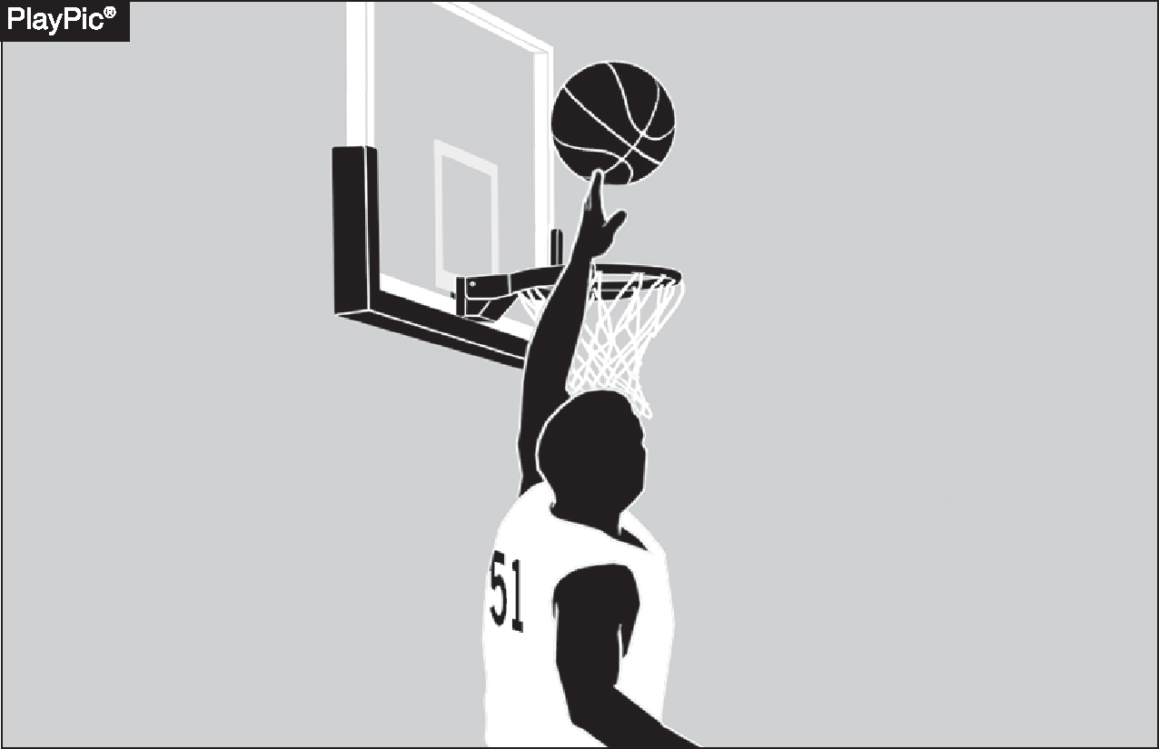
GOALTENDING
4-22-1
Goaltending occurs when a defensive player touches the ball during a try or tap for field goal while the ball is on its downward flight entirely above the basket ring level, has the possibility of entering the basket in flight and is not touching the basket cylinder.
Notes:
Goaltending occurs when a defensive player touches the ball during a try or tap while it is:
On its downward flight,
Entirely above the level of the basket ring,
Has a possibility of entering the basket, and
Is not touching the basket cylinder.
All these conditions must be met for the action to be ruled goaltending.
This rule protects legitimate scoring attempts and ensures defenders do not unfairly interfere with shots on their way to the basket.

Slide 10
GOALTENDING
4-22-2
Goaltending occurs when a defensive player touches the ball outside the cylinder during a free-throw attempt.
Notes:
Goaltending occurs when a defensive player touches the ball outside the cylinder during a free-throw attempt.
Even though the ball is not in the cylinder, any defensive interference with a free throw is considered goaltending.
This rule ensures free throws remain uncontested and scoring attempts are protected.
Proper enforcement maintains the integrity and fairness of free-throw situations.

Slide 11
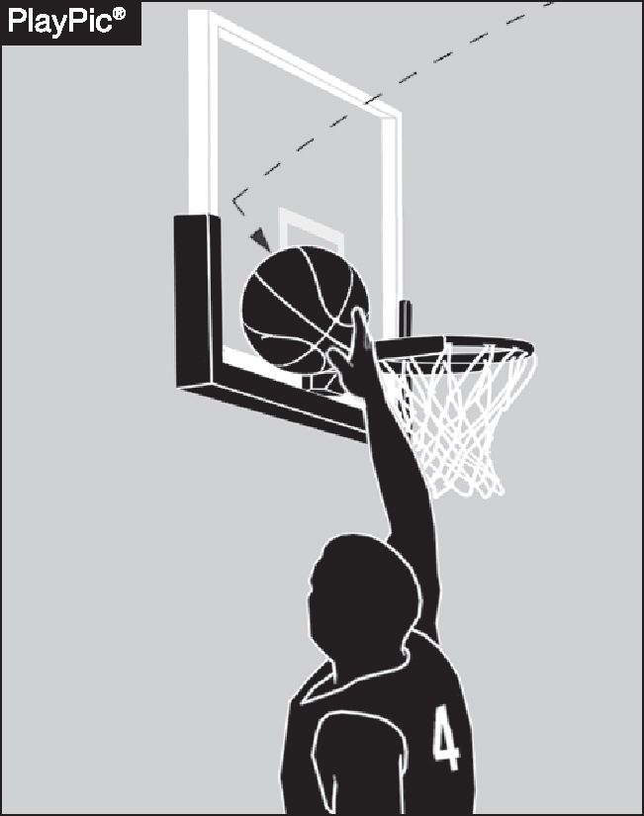
GOALTENDING
4-22-3 (NEW)
When the ball contacts the backboard, it is considered to be on its downward flight.
In such a case, it is goaltending when the ball is touched by a player as long as it has a possibility of entering the basket.
Notes:
When the ball contacts the backboard, it is considered to be on its downward flight.
If a player touches the ball after it hits the backboard, and the ball still has a possibility of entering the basket, it is considered goaltending.
This rule helps define the timing and legality of defensive plays involving the backboard.
Proper enforcement ensures fair scoring opportunities and prevents illegal interference with a shot attempt.

Slide 12
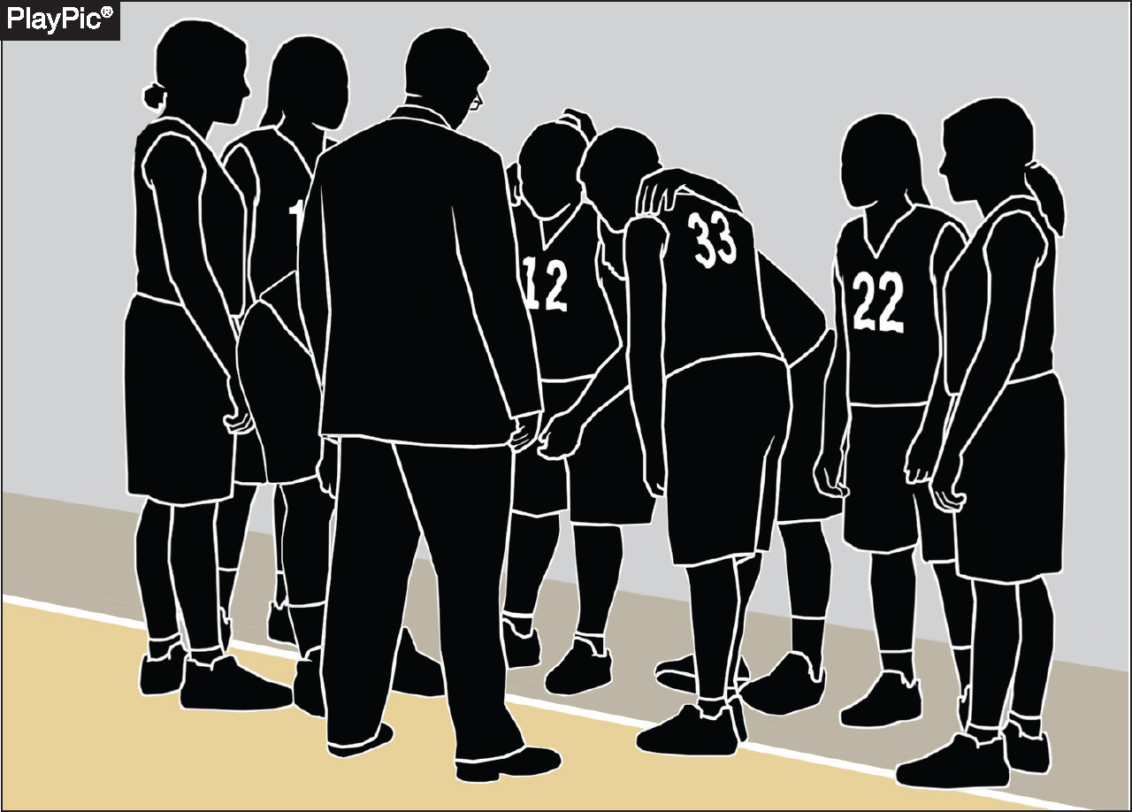
PLAYERS/BENCH PERSONNEL/ SUBSTITUTES/TEAM MEMBERS
4-34-1
A player is one of the five team members who are legally on the court at any given time, except during time-outs or intermissions. At which time they are considered bench personnel.
Notes:
A player is one of the five team members legally on the court during live play.
During timeouts or intermissions, those same individuals are considered bench personnel.
This distinction is important for determining roles, responsibilities, and potential penalties.
Helps officials and teams accurately apply rules regarding player conduct versus bench conduct.

Slide 13
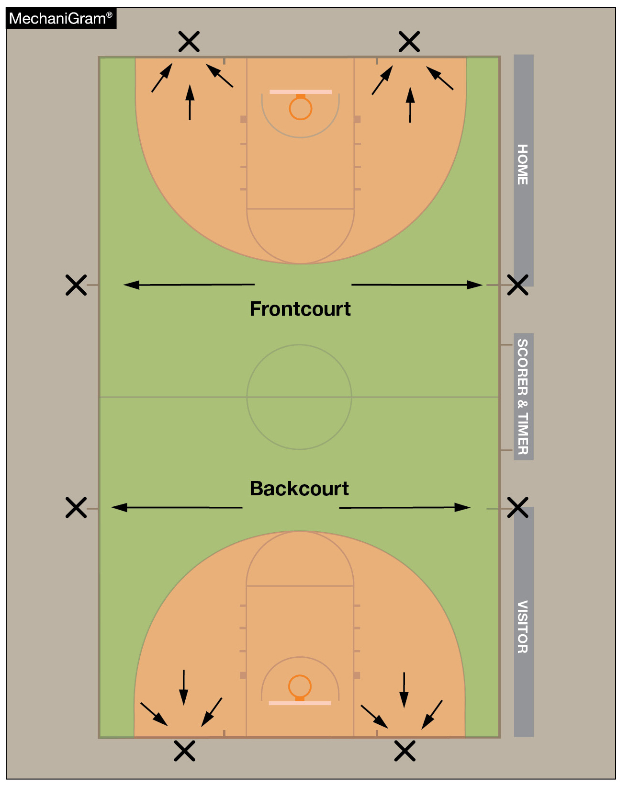
RESUMPTION-OF-PLAY PROCEDURE, THROW-INS 7-5-4
Officials shall determine the designated spot by using three-point line in the frontcourt or backcourt.
If the stoppage of play occurs on or within the three-point line, the designated spot shall be the nearest point on the end line three feet outside the lane line.
If the stoppage occurs outside the three-point line, the designated spot shall be the nearest sideline at the 28-foot-line.
Notes:
Officials determine the designated throw-in spot using the three-point line as a reference in both the frontcourt and backcourt.
If play is stopped on or within the three-point line, the throw-in spot is the nearest point on the end line, three feet outside the lane line.
If play is stopped outside the three-point line, the throw-in spot is the nearest sideline at the 28-foot line.
This guideline ensures consistency and clarity in locating throw-in positions after stoppages.
Proper enforcement promotes efficient game flow and fair placement of the ball during restarts.

Slide 14
THROW-IN PROVISIONS
9-2-11 (NEW)
The thrower shall not purposely and/or deceitfully delay returning after legally being out of bounds and then become the first player to touch the ball after returning to the playing court.
Notes:
A thrower shall not purposely or deceitfully delay returning to the court after legally being out of bounds during a throw-in.
The thrower may not be the first to touch the ball after re-entering the playing area in this manner.
This rule is designed to prevent deception and maintain fairness during throw-in situations.
Officials must watch for delayed or misleading movements by the thrower that could create an unfair advantage.
Enforcing this rule ensures proper conduct and positioning during and after throw-ins.

Slide 15
OUT OF BOUNDS
9-3-4 (NEW)
A player shall not purposely and/or deceitfully delay returning after legally being out of bounds and then become the first player to touch the ball after returning to the playing court.
Notes:
A player shall not purposely or deceitfully delay their return to the court after legally going out of bounds.
The player cannot be the first to touch the ball after re-entering the playing area in such a manner.
This rule prevents players from gaining an unfair advantage through deceptive tactics.
Proper enforcement supports fair play and integrity of on-court actions.
Officials must be alert to intentional delays or deceptive movements involving out-of-bounds situations.

Slide 16
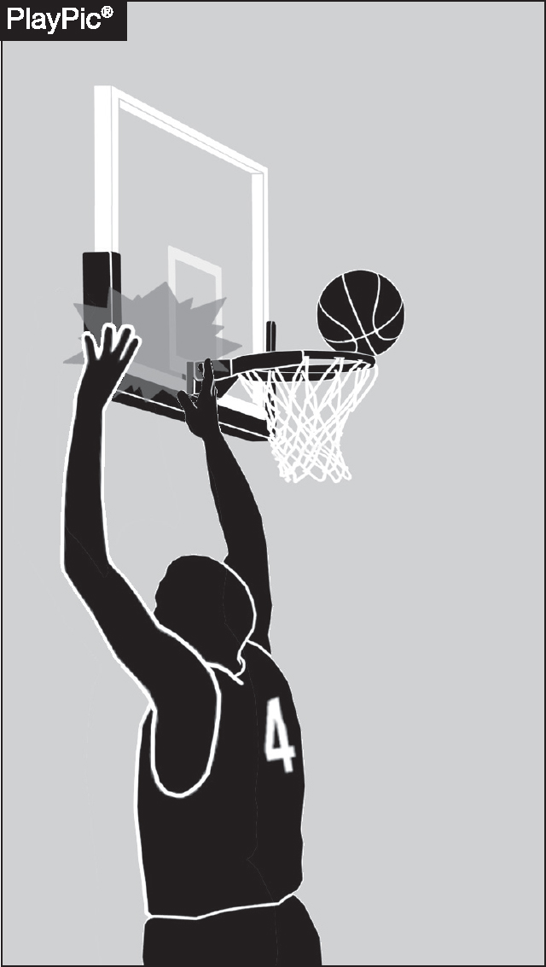
PLAYER TECHNICAL
10-4-4b
It is no longer an automatic technical foul if a player intentionally slaps or strikes the backboard or causes the ring to vibrate while a try or tap for the field goal is in flight or touching the backboard or is in the basket cylinder above the basket.
Notes:
It is no longer an automatic technical foul if a player intentionally slaps or strikes the backboard or causes the ring to vibrate while:
A try or tap for a field goal is in flight, or
The ball is touching the backboard, or
The ball is in the basket cylinder above the basket.
This represents a change in how such contact is penalized.
Officials now have discretion to assess the situation more carefully rather than issuing an automatic technical foul.
The rule aims to balance fair enforcement with avoiding overly harsh penalties for certain actions.

Slide 17
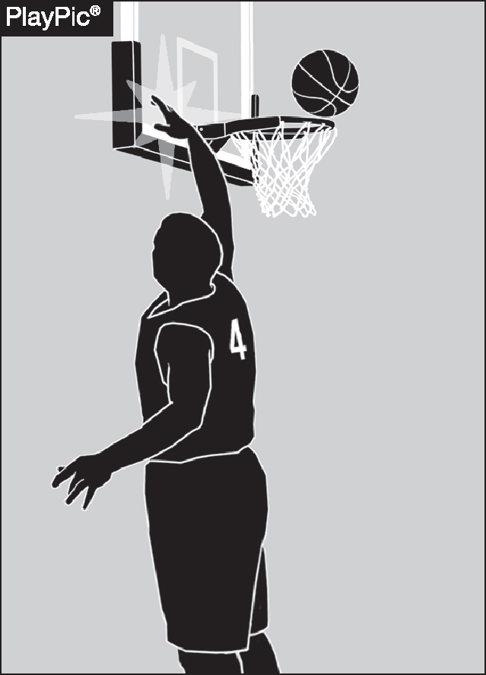
BASKET INTERFERENCE
4-6-1a, 4-6-1b
Basket interference now occurs when a player slaps or strikes the backboard causing the backboard or basket to vibrate while the ball is on or within either basket or is touching the backboard or within the cylinder.
Notes:
Basket interference is called when a player slaps or strikes the backboard, causing it to vibrate.
This applies while the ball is on or within either basket, or touching the backboard, or within the cylinder above the basket.
The rule prevents players from affecting the ball’s path by manipulating the backboard or basket.
Enforcing this maintains fair play and integrity of scoring opportunities.
Officials must be alert to such contact to properly apply basket interference penalties.

Slide 18
2025-26 NFHS Basketball
Editorial Changes

Slide 19
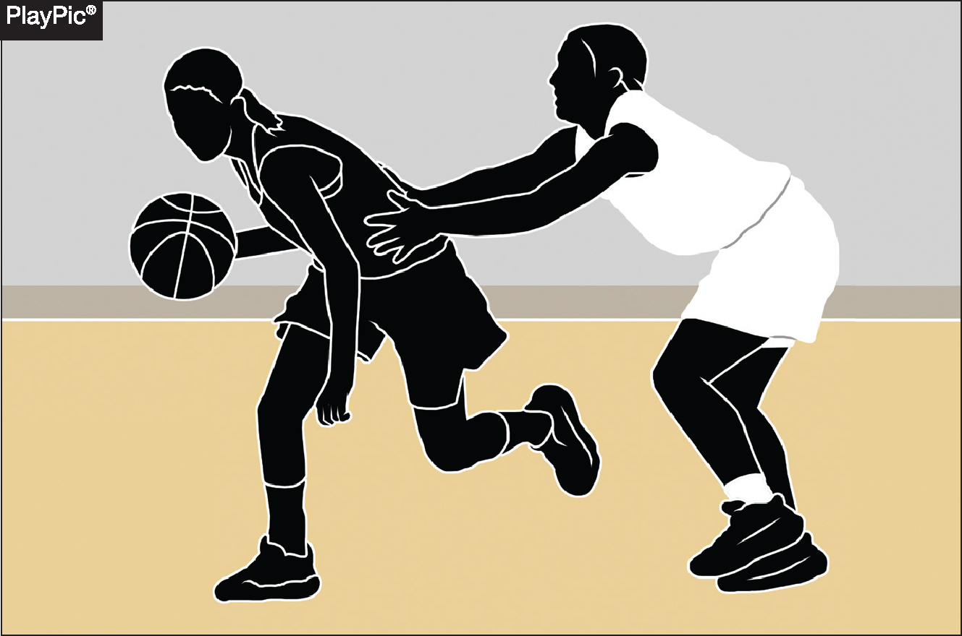
FOUL
4-19-3c
Contact — made with the sole intent to manipulate the clock — is no longer automatically categorized as intentional. Instead, officials are expected to judge contact based on more physical and safety-related criteria.
Notes:
Contact made solely to manipulate the clock is no longer automatically ruled intentional.
Officials are now expected to judge such contact based on physicality and safety concerns rather than intent alone.
The focus is on assessing whether the contact is excessive, dangerous, or compromises player safety.
This change encourages a more nuanced and fair evaluation of contact during the game.
Helps prevent automatic harsh penalties when the contact is minor and not unsafe.

Slide 20
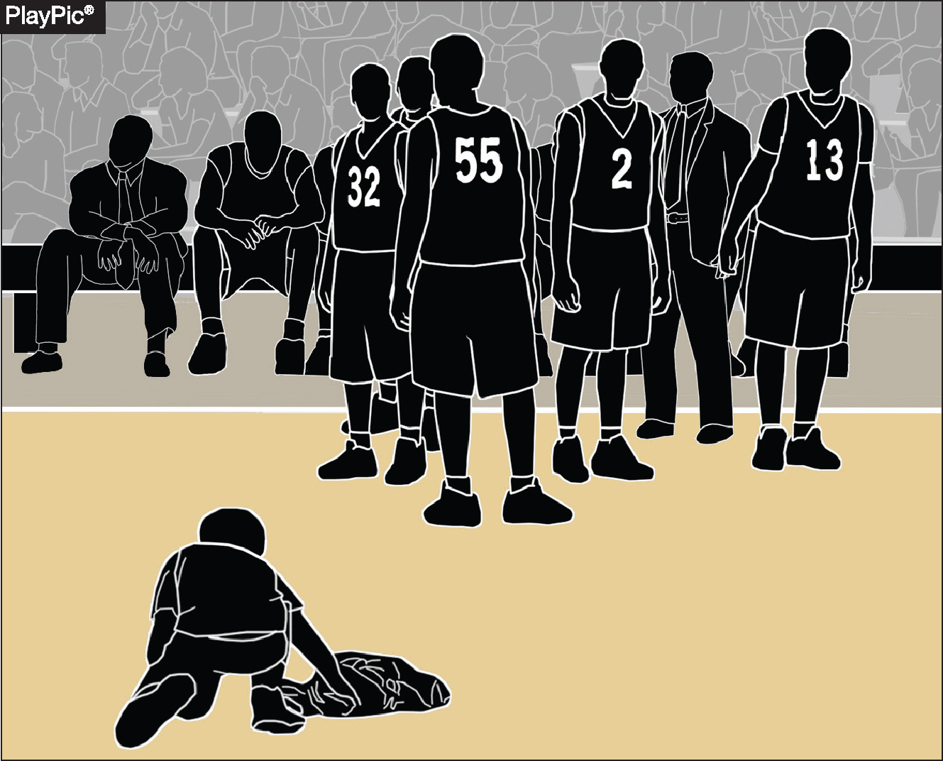
WARNING FOR DELAY
4-47
A warning to a team for actions that cause the game to be delayed is an administrative procedure by an official which is recorded in the scorebook by the scorer and reported to the head coach.
If a team’s actions do not delay a resumption of play, no warning is needed.
Notes:
A warning to a team for actions causing game delay is an official administrative procedure.
The warning is recorded in the scorebook by the scorer.
The warning is reported to the head coach by the official.
If the team’s actions do not delay the resumption of play, no warning is necessary.
This procedure helps maintain game flow and discipline.
Ensures teams are held accountable for delays that affect the pace of the game.

Slide 21
THREE-POINT TRY
5.2.1 SITUATION C
If the offense throws the ball from beyond the three-point line, when there is no possibility of the ball entering the basket from above and touching/deflection by another player causes the goal to be successful, it shall be a two-point goal.
Notes:
If the offense throws the ball from beyond the three-point line, but the ball cannot enter the basket from above (e.g., a throw that hits the backboard or rim in a way that it’s not a direct shot).
And if the ball is then touched or deflected by another player causing the ball to go in,
The resulting goal is counted as a two-point field goal, not three points.
This rule clarifies scoring when the shot attempt is not a direct successful three-point try.

Slide 22
JUMP-BALL ADMINISTRATION
6-3-2a, 6-3-5b
Prior to the ball being tossed for a jump ball, nonjumpers shall not move onto the center restraining circle (within three feet).
Until the tossed ball is touched by one or both jumpers, nonjumpers shall not take a position in any occupied space within three feet of the center restraining circle.
Notes:
Before the ball is tossed for a jump ball, nonjumpers must stay off the center restraining circle, maintaining a distance of at least three feet from it.
Until the tossed ball is touched by one or both jumpers, nonjumpers cannot occupy any space within three feet of the center restraining circle that is already occupied.
These rules help ensure a fair and safe jump ball procedure.
Proper enforcement prevents interference or congestion around the jump ball area.
Maintains clear boundaries for player positioning at the start of play.

Slide 23
2025-26 NFHS Basketball
Other Changes

Slide 24
CONTINUOUS MOTION
4.11.2 SITUATION (NEW)
Under NFHS rules, a player who is pivoting or stepping when fouled is considered to have begun the try attempt.
The player should be considered in the act of shooting if the player continues the motion and releases the ball on a try.
Notes:
A player who is pivoting or stepping when fouled is considered to have begun a try attempt.
If the player continues the shooting motion and releases the ball, they are considered to be in the act of shooting.
This rule helps determine when a foul results in shooting foul penalties (like free throws).
Proper application ensures accurate calls related to fouls during shooting attempts.
It clarifies the timing of when a try officially starts in relation to player movement and fouls.

Slide 25
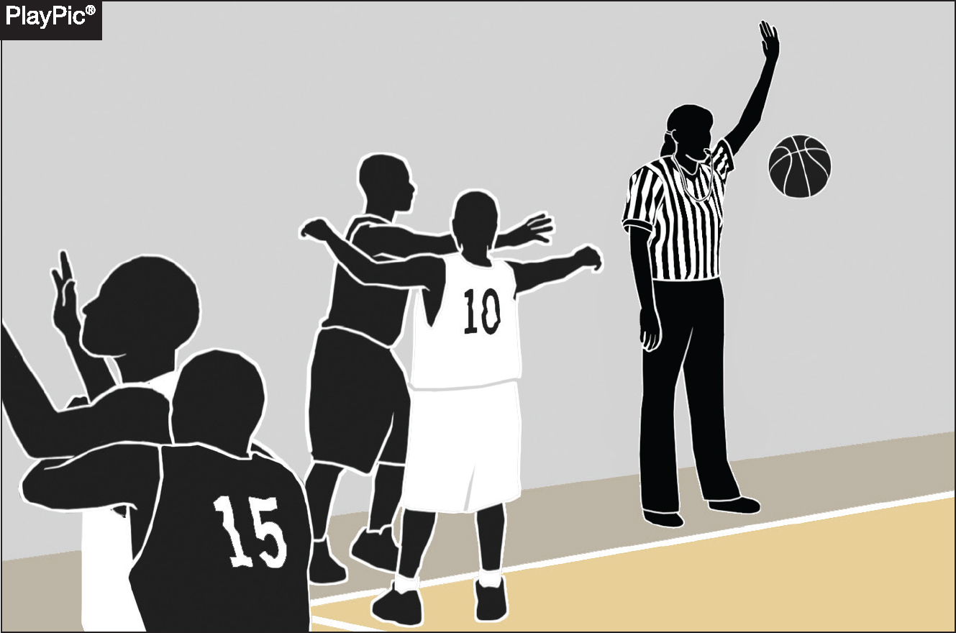
PLAYER AND/OR TEAM CONTROL
4.12.2 SITUATION C (NEW)
If an official blows an inadvertent whistle during the loose ball following a throw-in, the team making the throw-in remains in team control and should be awarded the subsequent throw-in that resumes play at the point of interruption.
Notes:
If an official blows an inadvertent whistle during a loose ball following a throw-in:
The team that made the throw-in retains team control.
That team is awarded the subsequent throw-in to resume play.
The throw-in occurs at the point where play was interrupted.
This ensures fairness by maintaining possession for the team that originally had control.
Proper enforcement helps prevent unintended advantages caused by officiating errors.

Slide 26
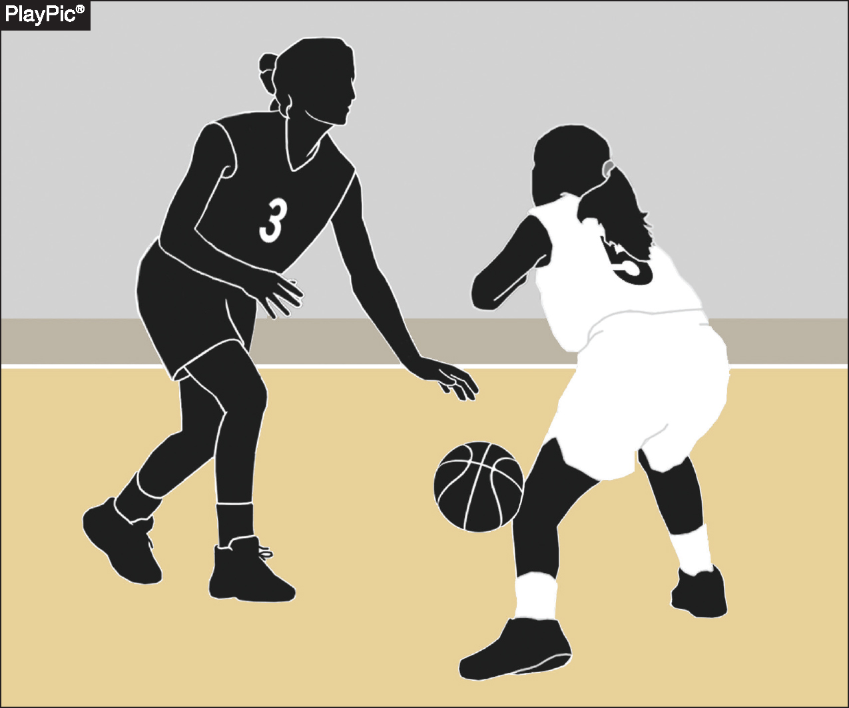
DRIBBLE — LEGAL AND ILLEGAL MOVEMENT
4.15 COMMENT
It is a dribble when the player is in control of the ball, bats, throws or pushes the ball to the floor, and is the first to touch the ball after it returns from the floor.
Notes:
This definition clarifies what actions constitute a legal dribble.
Proper recognition helps officials accurately distinguish between dribbling and other ball-handling violations.

Slide 27
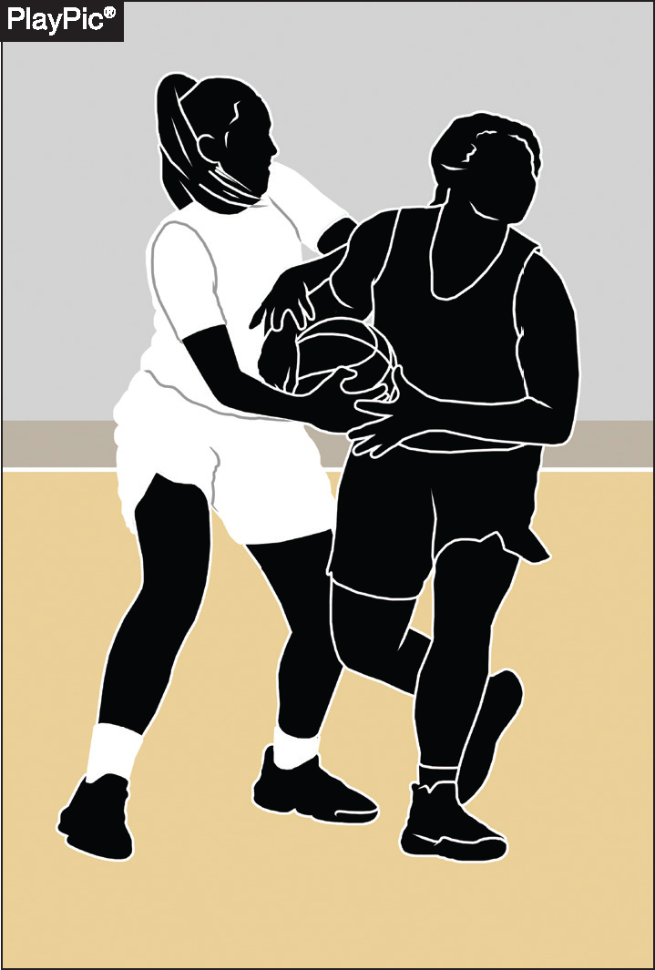
HELD BALL
4.25.1 SITUATION (NEW)
Two opponents do not need to both have two hands on the ball to cause a held ball.
When officials judge the ball cannot be controlled by a player without causing undue roughness, a held ball should be called.
Notes:
A held ball can be called even if only one opponent has two hands on the ball; both players don’t need to have two hands on it.
Officials should call a held ball when they judge that a player cannot control the ball without causing undue roughness.
The focus is on maintaining player safety and preventing excessive physical contact.
Proper enforcement helps ensure fair play and minimizes unnecessary roughness during ball contests.

Slide 28
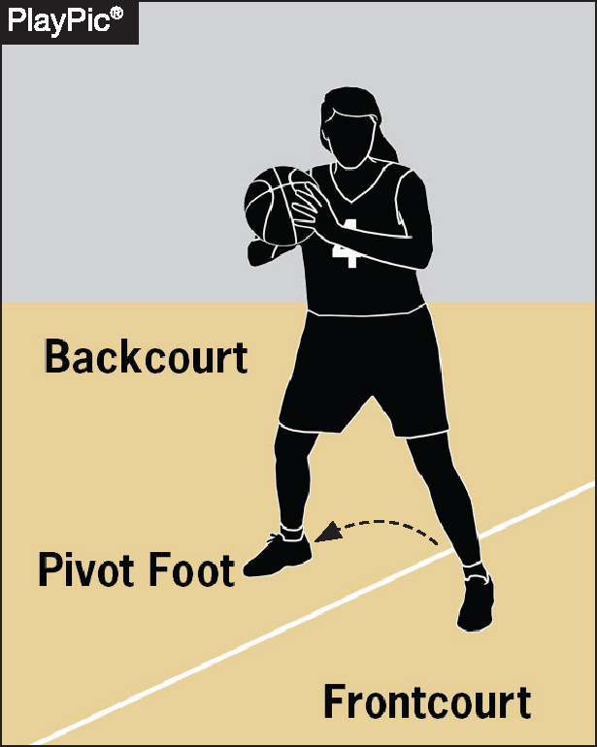
FRONTCOURT-BACKCOURT
9.9.1 SITUATION H (NEW)
It is a backcourt violation if an offensive player steps on, but not over, the division line, or steps into the backcourt.
Notes:
A backcourt violation occurs if an offensive player:
Steps on (but not over) the division line, or
Steps into the backcourt area.
The rule emphasizes that even touching the division line counts as a violation.

Slide 29
DELAY RETURNING TO COURT,
TEAM TECHNICAL
10.4.2 SITUATION B, 10-2-5
If all five offensive players fail to return to the court at approximately the same time, the offensive team is charged with a team technical foul.
Notes:
All five offensive players must return to the court at approximately the same time after a stoppage.
If the offensive players fail to do so, the team is assessed a team technical foul.
This rule promotes orderly and timely resumption of play.

Slide 30
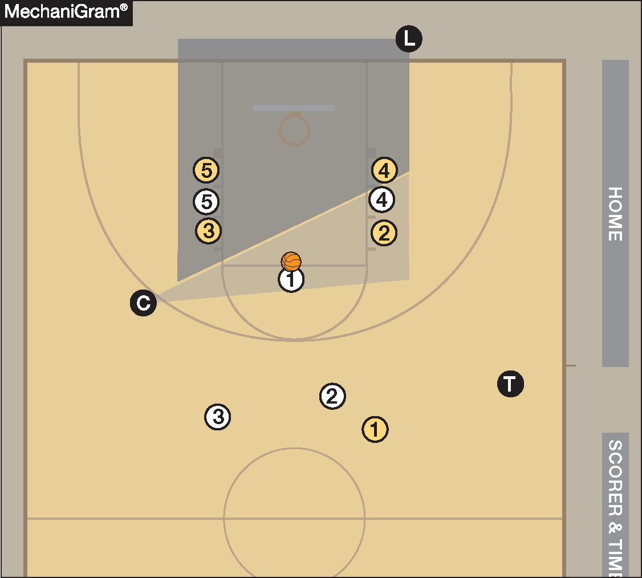
OFFICIALS MANUAL
RULE 5-11 COVERAGE
The trail official should assist the lead and center officials in monitoring free-throw lane activity and is primarily responsible for monitoring players above the free-throw line extended and outside the three-point arc.
Notes:
“Approximately the same time” means players must come back in a coordinated manner. It does not require simultaneous steps, but they must be clearly rejoining play together.
Applies only to the offensive team, likely because they control positioning for set plays after timeouts and can exploit delayed entry.
This is a team technical foul (not a player technical), so it doesn't count toward an individual player's technical foul total.

Slide 31
2025-26 NFHS Basketball
Points of Emphasis

Slide 32
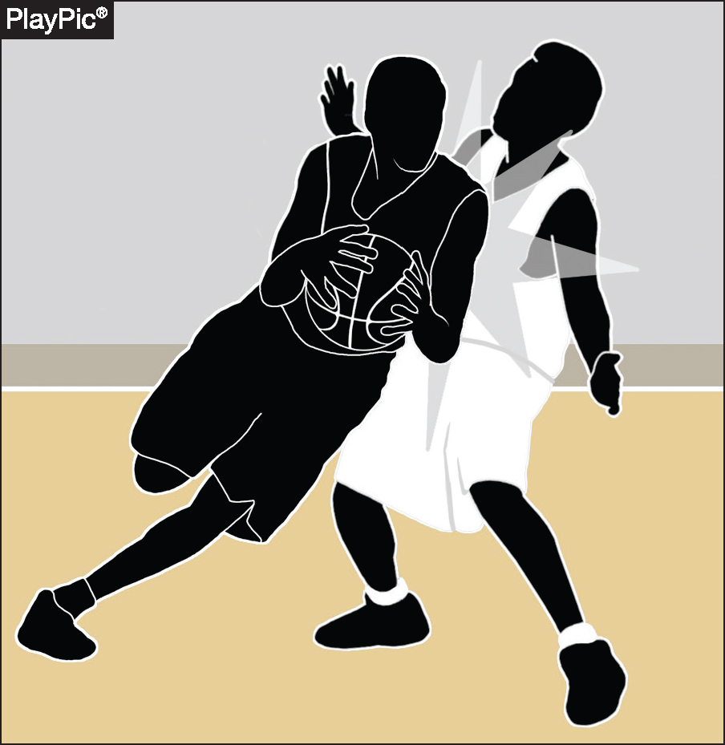
CONTACT ON THE BALL HANDLER
While hand-checking remains a known concern, other forms of illegal contact must also be recognized and penalized.
Defenders may not use their hips, torsos or other parts of the body to displace, re-direct or impede a ball handler’s freedom of movement.
Notes:
Goal: Freedom of Movement
The rule reinforces that ball handlers must be allowed to move freely, and any illegal restriction, even if subtle or non-hand-related, should be penalized.

Slide 33
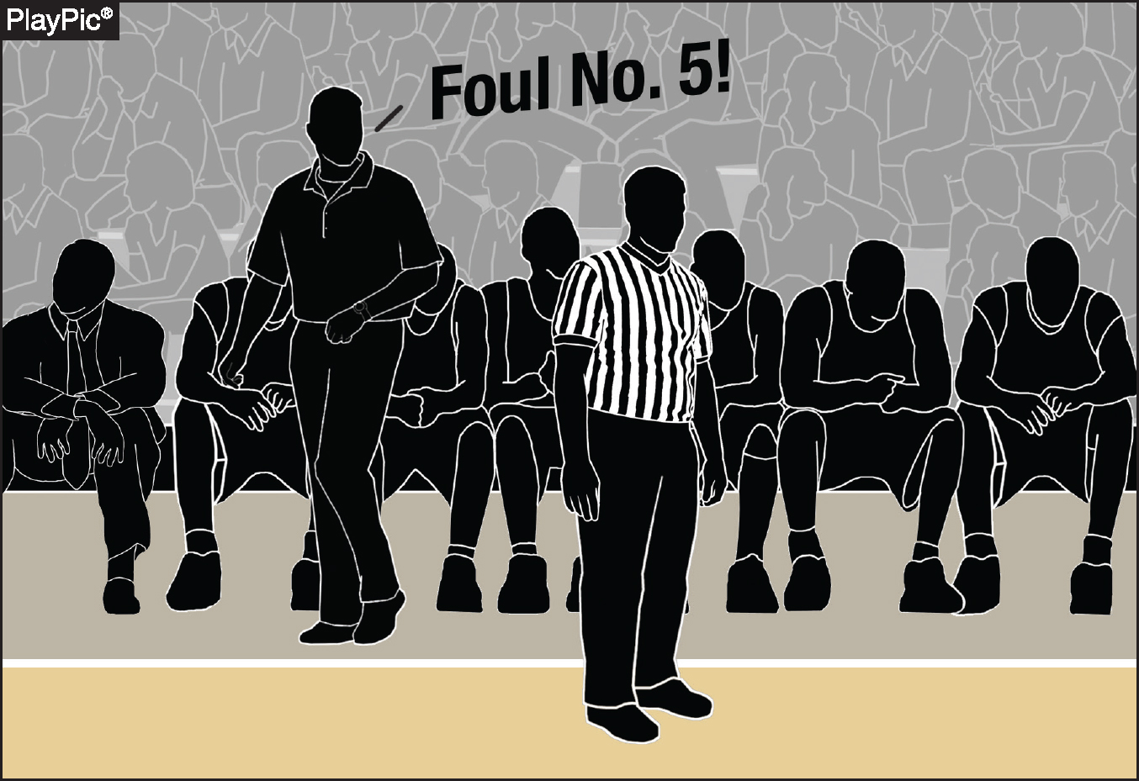
CONTACT ON THE BALL HANDLER
Particular attention is required in late-game scenarios. Not all fouls committed in the closing moments of a contest are necessarily intentional.
Determinations on such rulings must center on the acts themselves, not verbal directives coming from the coaching staff.
Notes:
Not All Late Fouls Are Intentional: A foul committed late in the game is not automatically intentional just because of the timing or situation.
Actions Over Instructions: The decision to call an intentional foul must be based on the nature of the contact, not on whether a coach verbally instructed their players to foul.
Focus on the Act, Not the Intent: Officials must judge the contact itself
Ensures Game Integrity: This guidance helps maintain fair play and prevents automatic assumptions about players’ motives during critical game moments.

Slide 34
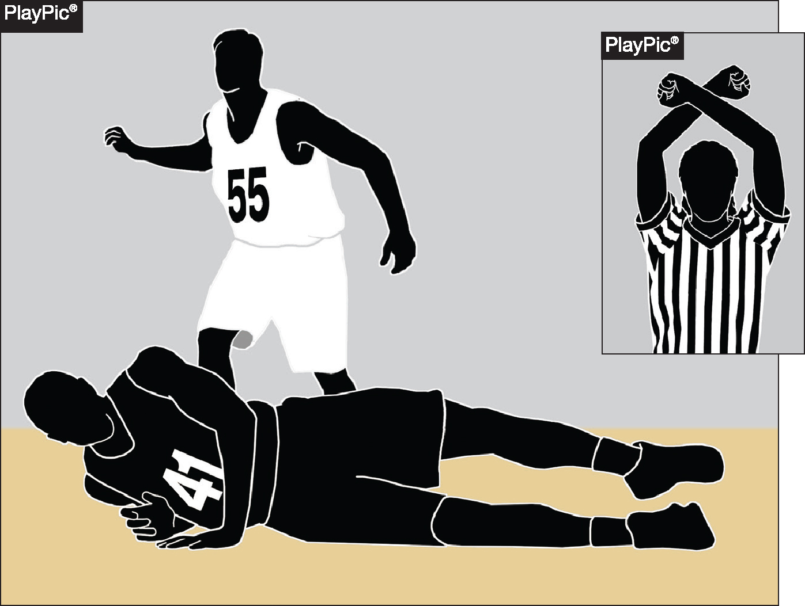
CONTACT ON THE BALL HANDLER
Contact that is excessive, clearly removes an opponent’s apparent advantage or does not constitute a legitimate basketball play should still be classified as an intentional foul.
Instructional emphasis must be placed on teaching players how to commit legal fouls within the parameters of the rules.
Notes:
1. Contact should be ruled intentional if it:
Is excessive,
Removes an opponent’s clear advantage, or
Is not a legitimate basketball play (e.g., grabbing, pushing, or wrapping up).
2. Instructional Emphasis for Coaches: Coaches must teach players how to commit legal fouls—within the rules and spirit of the game—not just how to stop the clock or interrupt play.

Slide 35
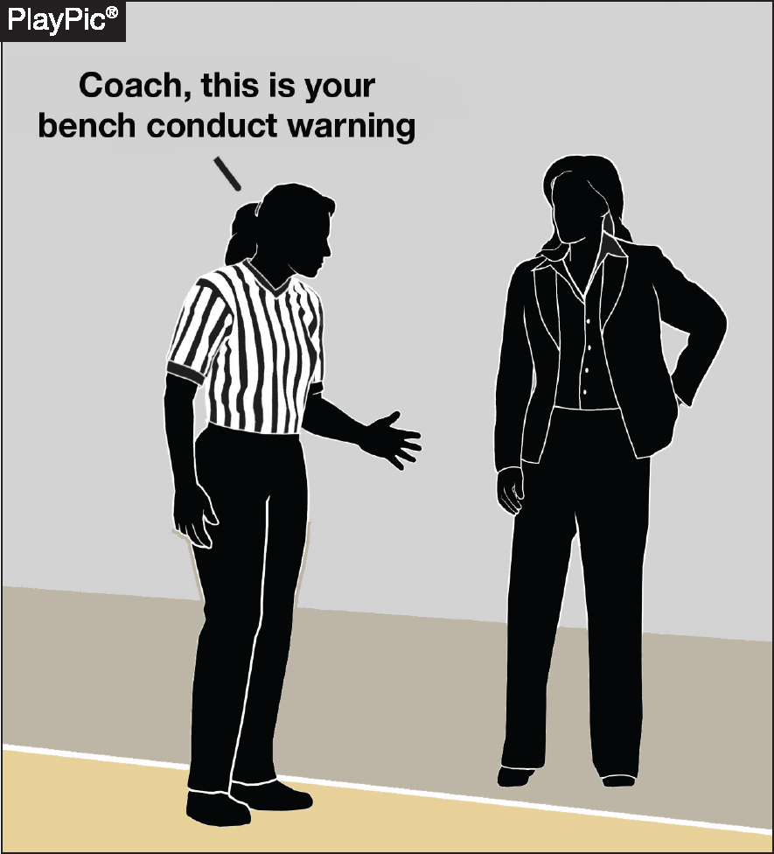
BENCH DECORUM, COMMUNICATION AND PLAYER ALTERCATIONS
Officials are expected to take a proactive role in managing coach and bench behavior, particularly regarding the conduct of head and assistant coaches.
Rule 4-48 (warning for coach/team conduct) should be applied early and consistently to prevent escalation and maintain game control.
Notes:
1. Proactive Officiating Required: Officials must actively manage coach and bench behavior throughout the game. Focus is especially on head and assistant coaches who set the tone for team conduct.
2. Rule 4-48 – Warnings for Conduct: Use Rule 4-48 (team/coach conduct warning) early and consistently:
Helps de-escalate potential issues.
Reinforces boundaries before misconduct becomes problematic.
3. Game Control & Professionalism: Timely application of warnings promotes respect for the game, helps maintain official authority, and ensures smooth game flow.
4. Prevention Over Reaction: The goal is to prevent escalation, not just react after it occurs.

Slide 36
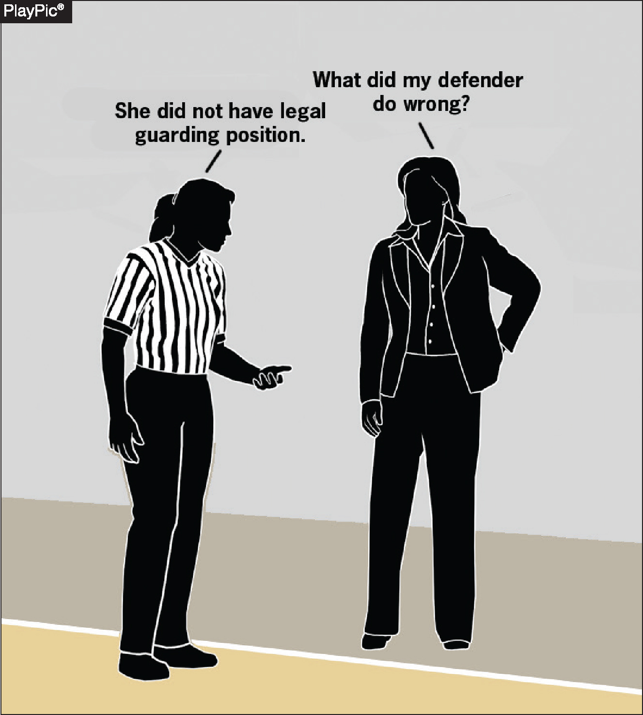
BENCH DECORUM, COMMUNICATION AND PLAYER ALTERCATIONS
Rules-based questions are appropriate and should receive a clear and informative response, as these interactions support the educational purpose of the game.
Rhetorical questions or comments not seeking clarification do not require a response.
Notes:
1. Support Educational Interactions:
Rules-based questions from coaches are appropriate.
Officials should respond with clear, informative answers to support the educational mission of high school athletics.
2. Distinguish Between Constructive and Rhetorical:
Genuine questions seeking clarification deserve a response.
Rhetorical remarks or emotional comments that do not seek understanding do not require a reply.
3. Promote Respectful Dialogue:
Encouraging meaningful communication helps build rapport and mutual respect between coaches and officials.
4. Stay Focused & Professional:
Officials should maintain composure and engage only in productive exchanges that contribute to game understanding.

Slide 37
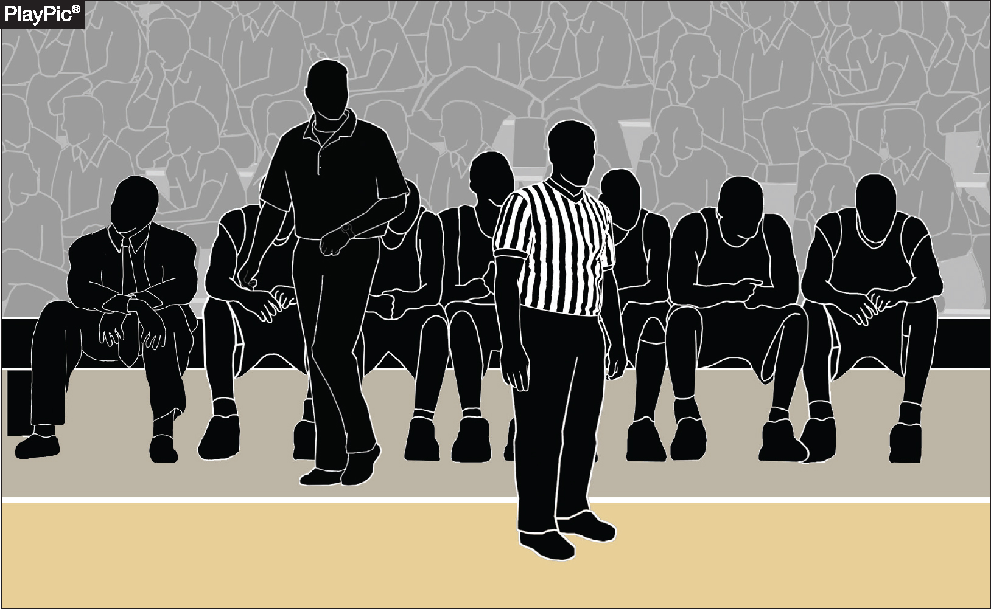
BENCH DECORUM, COMMUNICATION AND PLAYER ALTERCATIONS
Rule 10-5 spells out the privileges and restrictions for head coaches and bench personnel.
Only head coaches may stand and provide instructions to players during live-ball play. All other personnel must remain seated except during rule-specified situations such as timeouts or spontaneous reactions to exceptional play.
Notes:
1. Head Coach Standing Privilege:
Only the head coach is permitted to stand and instruct players during live-ball play.
2. Restrictions for Bench Personnel:
Assistant coaches and other bench personnel must remain seated during live-ball action.
They may only stand in limited, rule-specified situations (e.g.:
During a timeout
For spontaneous reactions to an exceptional play
To confer with the scorer’s table under rule-allowed circumstances)
3. Purpose of the Rule:
Maintains professionalism and clear authority from the sideline.
Prevents disruptive behavior and supports game management.
4. Consistent Enforcement:
Officials should monitor the bench area and apply Rule 10-5 consistently to ensure fairness and order throughout the game.

Slide 38
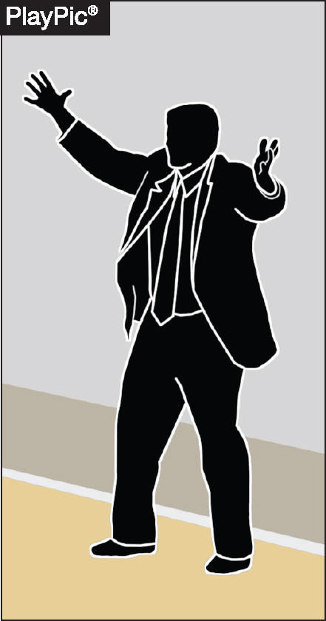
BENCH DECORUM, COMMUNICATION AND PLAYER ALTERCATIONS
Adherence to coaching-box boundaries is essential to maintaining safety and fairness.
Coaches stepping onto the court during live-ball play introduce potential safety concerns and must be addressed through rule enforcement.
Notes:
1. Coaching-Box Boundaries Must Be Respected:
Head coaches must remain within the designated coaching box during live-ball play.
Stepping outside the coaching box violates NFHS Rule 10-5 and compromises game decorum.
2. Safety Implications:
Coaches stepping onto the court during live play create potential safety hazards for players and officials.
Even brief encroachment may interfere with gameplay or official movement.
3. Fairness and Game Integrity:
Strict adherence ensures equal standards for both teams.
Prevents undue influence or distraction from the sideline during competition.
4. Enforcement Responsibility:
Officials must proactively monitor the coaching area.
Warnings or technical fouls may be issued if the behavior persists, in line with Rule 10-5 and Rule 4-48 (warnings).

Slide 39
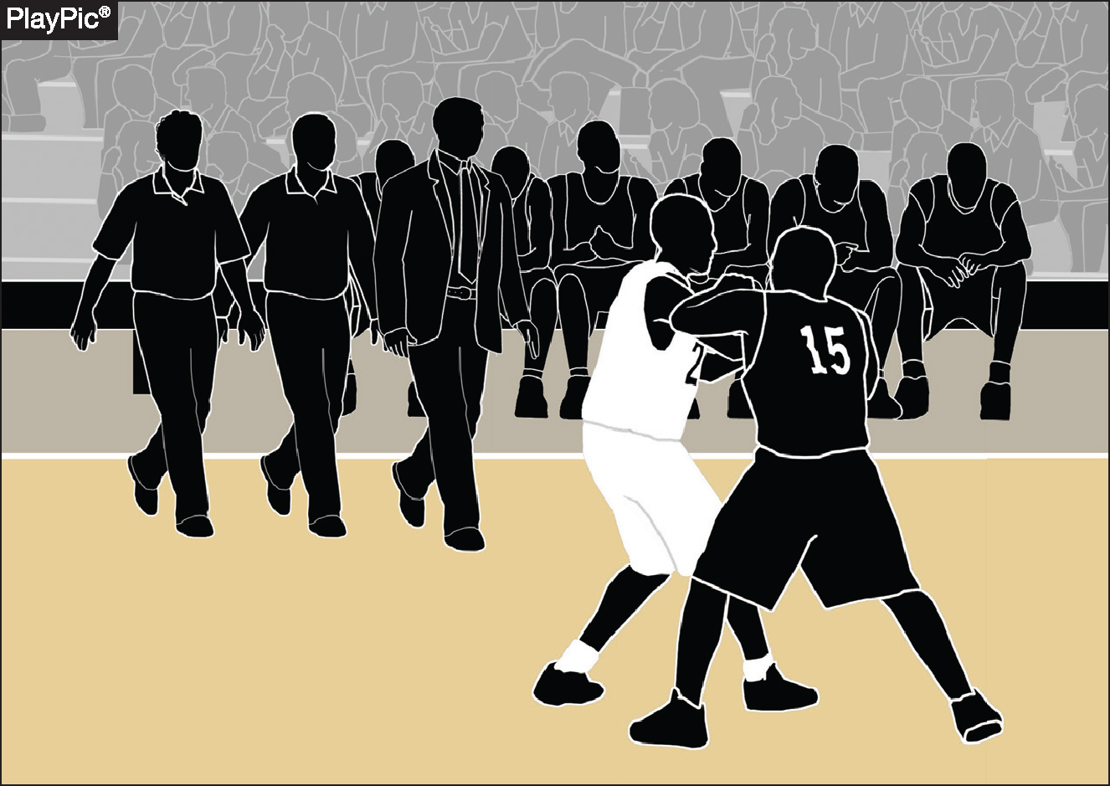
BENCH DECORUM, COMMUNICATION AND PLAYER ALTERCATIONS
The head coach holds primary responsibility for the prevention and de-escalation of potential altercations.
During an altercation, assistant coaches should be tasked with not only managing on-court players, but with controlling bench personnel.
Notes:
Primary Responsibility of the Head Coach: The head coach plays a crucial role in maintaining order and sportsmanship during a game. They are primarily responsible for identifying situations that could potentially escalate into conflicts and taking proactive steps to prevent them. This includes setting the tone for player behavior, communicating clearly with officials, and intervening early when tensions rise to de-escalate any brewing altercations.
Role of Assistant Coaches During Altercations: When an altercation does occur, assistant coaches have an important supporting role. They are tasked with managing the players who are actively participating on the court, ensuring they stay focused and do not escalate the situation further.
Additionally, assistant coaches must also control the behavior of bench personnel, including substitute players and support staff, to prevent the conflict from spreading or intensifying. This dual responsibility helps maintain overall team discipline and keeps the situation contained.

Slide 40
FAKING BEING FOULED
This point of emphasis reaffirms the adoption of rule 4-49 prior to the 2024-25 season, Warning for Faking Being Fouled, which addresses unsporting acts where players simulate illegal contact in an attempt to deceive officials and gain a competitive advantage.
Notes:
Officials must remain vigilant in detecting attempts by players to simulate fouls or illegal contact.
Consistently monitor player behavior to identify subtle or overt acts of deception.
Be ready to issue warnings or enforce penalties promptly to discourage faking fouls.
Maintain focus throughout the game, as players may try to exploit any lapse in officiating attention.
Uphold the integrity of the game by diligently enforcing Rule 4-49 to prevent players from gaining unfair advantages.
Use clear communication with players and coaches to reinforce that faking fouls will not be tolerated.

Slide 41
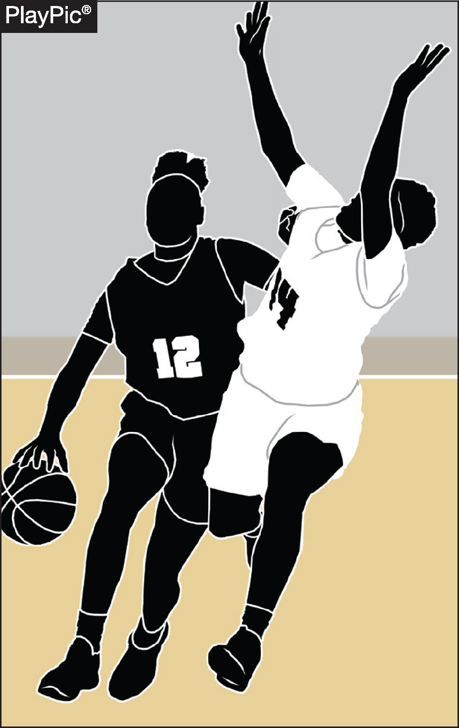
FAKING BEING FOULED
Examples of faking being fouled include head bobs by ball handlers, shooters who simulate being fouled during the act of shooting, and defensive players falling to the floor without contact.
Proper adjudication of these acts with the enforcement of rule 4-49 reinforces the importance of integrity in game play.
Notes:
Here are the key points related to examples of faking being fouled and Rule 4-49 enforcement:
Examples of faking being fouled include:
Ball handlers performing head bobs to simulate contact.
Shooters who exaggerate contact during their shooting motion.
Defensive players who fall to the floor without any contact to draw a foul call.
Proper enforcement of Rule 4-49 is essential in adjudicating these actions correctly.
Consistent rule enforcement discourages players from attempting to deceive officials and gain an unfair advantage.

Slide 42
NFHS Learning Center

Slide 43

Notes:
The NFHS Learning Center is the home to more than 90 online professional development courses for everyone within the interscholastic community - coaches, students, officials, parents, administrators, and individuals within performing arts programs. More than 60 courses are available for free.
The NFHS is an Accredited Institution and has delivered more than 15 million courses on its NFHS Learning Center platform since its inception in 2007. In receiving national accreditation by Cognia, the NFHS has upheld itself to rigorous standards that focus on productive learning environments, equitable resource allocation that meet the needs of learners, and effective leadership.
The NFHS Learning Center features its flagship coaching course, “Fundamentals of Coaching,” as well as several health and safety courses that have been completed by millions of individuals, such as “Concussion in Sports,” “Heat Illness Prevention,” “Sudden Cardiac Arrest” and “Protecting Students from Abuse.” The NFHS Learning Center offers several national credentials that can be earned by individuals who complete specific NFHS courses. Through the School Honor Roll Program, schools can earn a physical banner to hang in their school.
To learn more and start your professional development journey, please visit the NFHS Learning Center at NFHSLearn.com.

Slide 44
NFHS.org Phone # Email

